Slide 1
All Quite on the Western Front
by Erich Maria Remarque
All Quiet on The Western Front

Slide 2
Facts:
1914
Western fronts: trenches war, bombardments, biological weapon
Death poll: World War One was one of the deadliest conflicts in the history of the human race, in which over 16 million people died. The total number of both civilian and military casualties is estimated at around 37 million people.
Shell shock
https://www.youtube.com/watch?v=OK6ZTXrEUfc
The drama of war
All Quiet on The Western Front

Slide 3
Catastrophe, literature as witness and film as a reminder…
“This book is to be neither an accusation nor a confession, and least of all an adventure, for death is not an adventure to those who stand face to face with it. It will try simply to tell of a generation of men who, even though they may have escaped (its) shells, were destroyed by the war.”
All Quiet on the Western Front is a novel by Erich Maria Remarque, a German veteran of World War I. The book describes the German soldiers' extreme physical and mental stress during the war
Year: 1929
Im Westen nichts Neues, original title. Polish. Na Zachodzie bez zmian
All Quiet on The Western Front

Slide 4
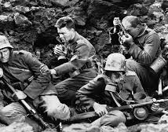
War War I… in the ideological game (story of the book/adaptation)
All Quiet on The Western Front

Slide 5
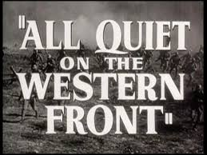
PAUL…
Paul Bäumer is the main character and narrator. At 18 years of age, Paul enlists in the German Army and is deployed to the Western Front where he experiences the severe psychological and physical effects of the war….
All Quiet on The Western Front

Slide 6
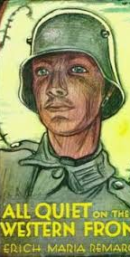
Albert Kropp
Kropp was in Paul's class at school and is described as the clearest thinker of the group as well as the smallest. Kropp is wounded towards the end of the novel and undergoes an amputation
All Quiet on The Western Front

Slide 7
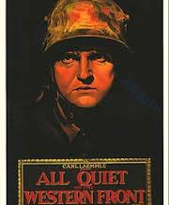
KAT
STANISLAUS "KAT" KATCZINSKY
Kat has the most positive influence on Paul and his comrades on the battlefield. Katczinsky was a cobbler in civilian life; he is older than Paul Bäumer and his comrades, about 40 years old, and serves as their leadership figure. He also represents a literary model highlighting the differences between the younger and older soldiers. While the older men have already had a life of professional and personal experience before the war, Bäumer and the men of his age have had little life experience or time for personal growth.
All Quiet on The Western Front

Slide 8
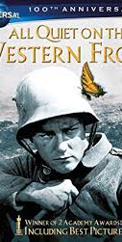
Reading
https://www.youtube.com/watch?v=pSrhR4EXido
All Quiet on The Western Front

Slide 9
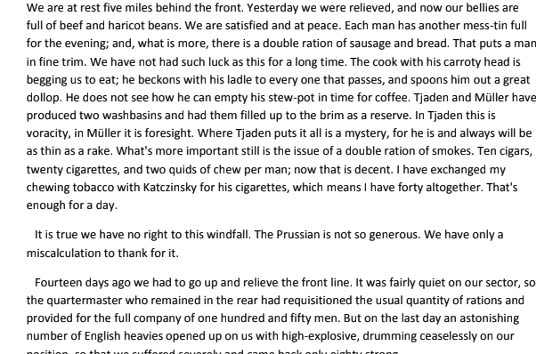
The beginning
All Quiet on The Western Front

Slide 10
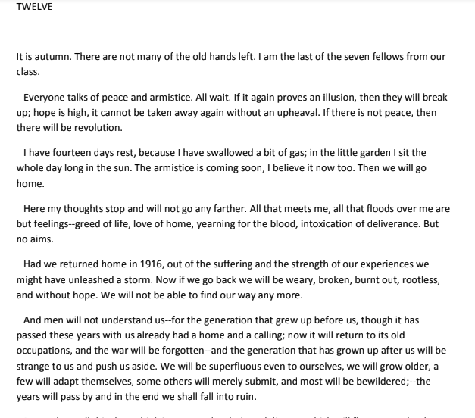
The lost generation
All Quiet on The Western Front

Slide 11
The end….
All Quiet on The Western Front

Slide 12
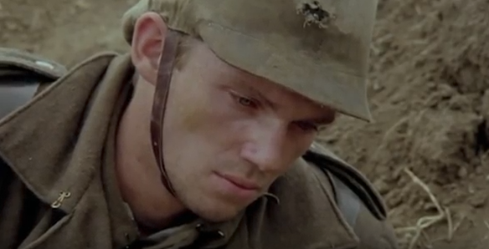
FILM
BOOK
FROM THE SCHOOL
SETTING THE SCENE
TRENCHES
All Quiet on The Western Front

Slide 13
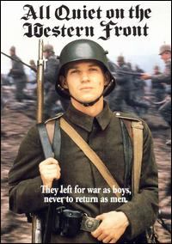
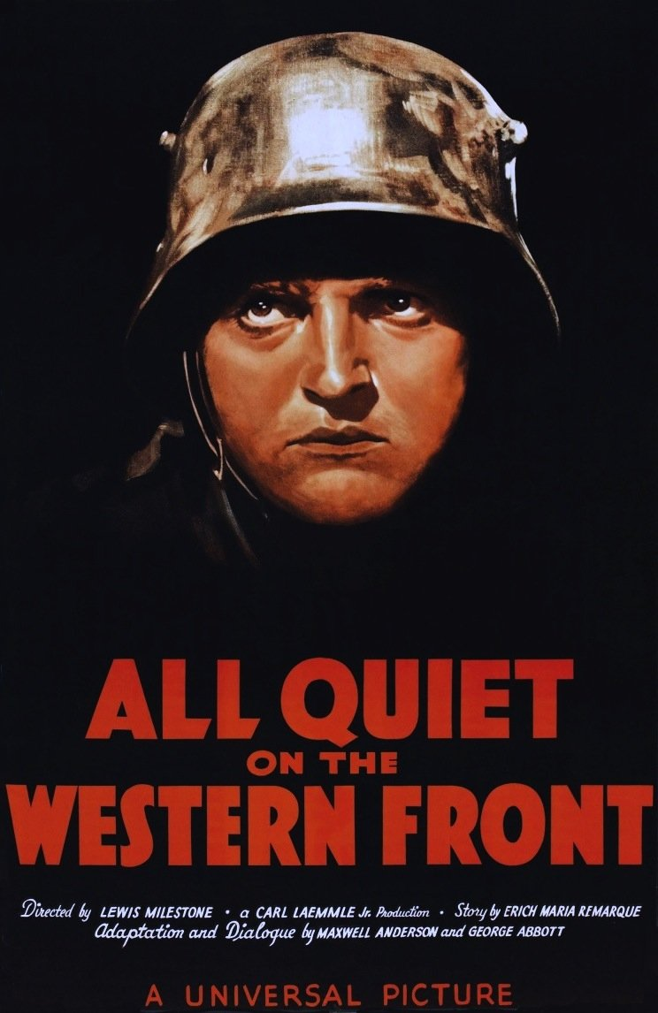
Adaptations
All Quiet on the Western Front is a television film produced by ITC Entertainment, released on November 14, 1979, starring Richard Thomas and Ernest Borgnine. The 1979 film was directed by Delbert Mann.
In 1930, an American film of the novel was made, directed by Lewis Milestone; with a screenplay by Maxwell Anderson.

Slide 14
Bildungsroman
School
The IRON YOUTH
PATRIOTIC INDOCRINATION
Ending…. (butterfly/bird episodes)
1930 ending:
https://www.youtube.com/watch?v=nMlDPsRwZE4
All Quiet on The Western Front

Slide 15
https://www.youtube.com/watch?v=sTKCg-ufHuM
1:16h
Face to Face with the “enemy”
1930 adaptation https://www.youtube.com/watch?v=mw96cSYo9dU
All Quiet on The Western Front

Slide 16
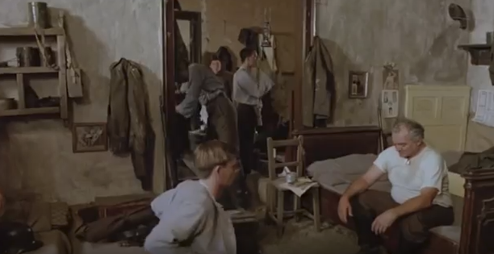
War as ideology
Kat: somebody has a profit out of it….
What for?
All Quiet on The Western Front

Slide 17
Film
https://www.youtube.com/watch?v=sTKCg-ufHuM
All Quiet on The Western Front

Slide 18
WARS in cinema
Judgment at Nuremberg, 1961
Medaliony, 1963
https://www.youtube.com/watch?v=jf_qkEXrxKs&vl=pl
Apocalypse Now, 1979
The Schindler’s List, 1993
Forest Gump, 1994
Saving Private Ryan, 1998
All Quiet on The Western Front

Slide 19
Questions
The characterization of the central character of Paul Bäumer?
Life versus Ideas in Remarque’s book?
The role of history in the cultural production?
All Quiet on The Western Front

